Slide 1
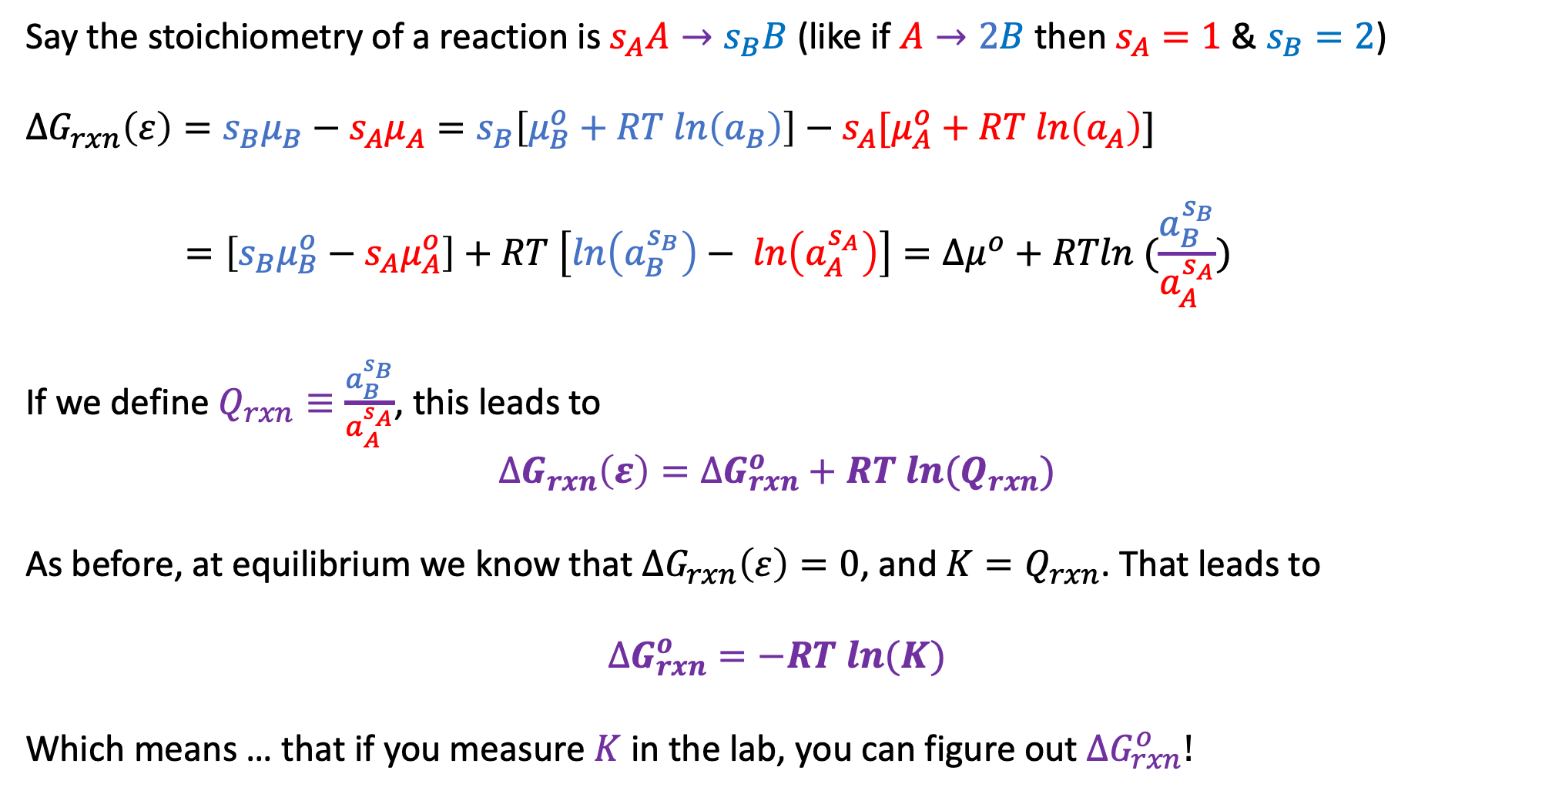
Generalization of a derivation we did last week
Say the stoichiometry of a reaction is $s_{A}A→s_{B}B$ (like if $A→2B$ then $s_{A}=1$ & $s_{B}=2$)
$$∆G_{rxn}\left(ε\right)={s_{B}μ}_{B}−{s_{A}μ}_{A}=s_{B}\left[μ_{B}^{o}+RT ln\left(a_{B}\right)\right]−s_{A}[μ_{A}^{o}+RT ln\left(a_{A}\right)]$$
$$=\left[s_{B}μ_{B}^{o}−{s_{A}μ}_{A}^{o}\right]+RT \left[ln\left(a_{B}^{s_{B}}\right)− ln\left(a_{A}^{s_{A}}\right)\right]=∆μ^{o}+RTln (\frac{a_{B}^{s_{B}}}{a_{A}^{s_{A}}})$$
If we define $Q_{rxn}≡\frac{a_{B}^{s_{B}}}{a_{A}^{s_{A}}}$, this leads to
$$∆G_{rxn}\left(ε\right)=∆G_{rxn}^{o}+RT ln{(Q}_{rxn})$$
As before, at equilibrium we know that $∆G_{rxn}\left(ε\right)=0$, and ${K=Q}_{rxn}$. That leads to
$$∆G_{rxn}^{o}=−RT ln(K)$$
Which means … that if you measure $K$ in the lab, you can figure out $∆G_{rxn}^{o}!$

Slide 2
Today
Non-PV work
Definition
Electrical work associated with moving around single ions, moles of ions
Concentration work
Context for CGI exercises
Relationship to Gibbs and the 2nd Law

Slide 3
Today
Non-PV work
Definition
Electrical work associated with moving around single ions, moles of ions
Concentration work
Context for CGI exercises
Relationship to Gibbs and the 2nd Law

Slide 4
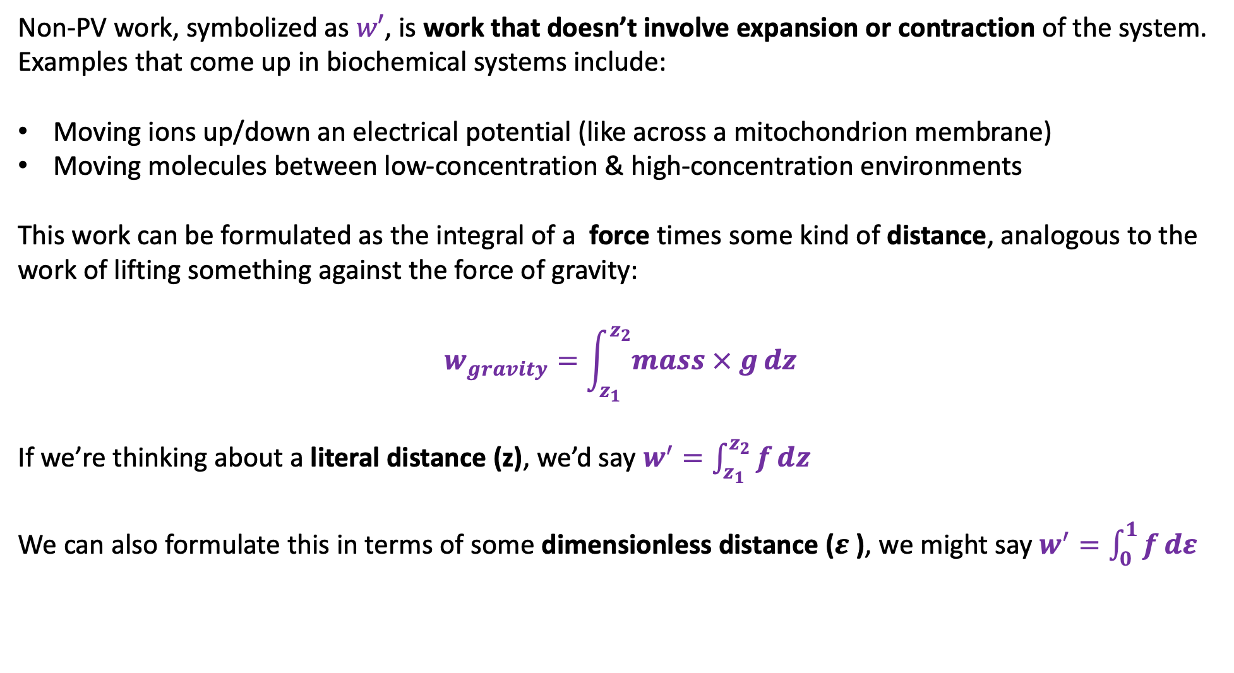
Definition of non-PV work
Non-PV work, symbolized as $w′$, is work that doesn’t involve expansion or contraction of the system. Examples that come up in biochemical systems include:
Moving ions up/down an electrical potential (like across a mitochondrion membrane)
Moving molecules between low-concentration & high-concentration environments
This work can be formulated as the integral of a force times some kind of distance, analogous to the work of lifting something against the force of gravity:
$$w_{gravity}=\int_{z_{1}}^{z_{2}}{mass × g}dz$$
If we’re thinking about a literal distance (z), we’d say $w^{′}=\int_{z_{1}}^{z_{2}}{f}dz$
We can also formulate this in terms of some dimensionless distance ($ε$ ), we might say $w^{′}=\int_{0}^{1}{f}dε$

Slide 5
Today
Non-PV work
Definition
Electrical work associated with moving around single ions, moles of ions
Concentration work
Context for CGI exercises
Relationship to Gibbs and the 2nd Law

Slide 6
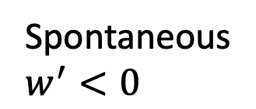


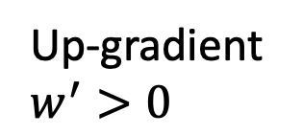
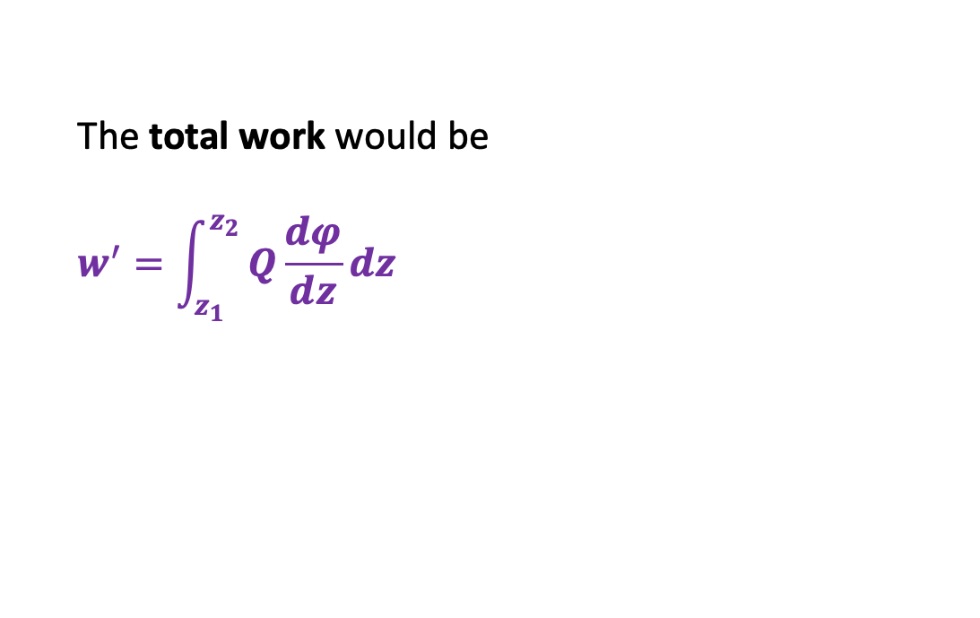



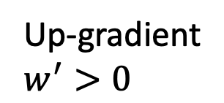

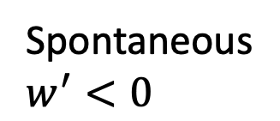

Electrical work for single ions
The total work would be
$$w^{′}=\int_{z_{1}}^{z_{2}}{Q\frac{dφ}{dz}}dz$$
$f=Q\frac{dφ}{dz}$
$distance=z$
$$E.g., Q_{proton}=1.6×{10}^{−19} C$$
-
+
-
+
$$e^{−}$$
-
Up-gradient
$$w^{′}>0$$
Spontaneous
$$w^{′}<0$$
+
-
+
-
+
$$H^{+}$$
-
Spontaneous
$$w^{′}<0$$
Up-gradient
$$w^{′}>0$$
+
-
+
$$φ$$
$$∆φ$$
$$∆z$$
$$z$$

Slide 7

Electrical work for single ions
The total work would be
$$w^{′}=Q\int_{z_{1}}^{z_{2}}{\frac{dφ}{dz}}dz$$
$f=Q\frac{dφ}{dz}$
$distance=z$
$$E.g., Q_{proton}=1.6×{10}^{−19} C$$
-
+
-
+
$$e^{−}$$
-
Up-gradient
$$w^{′}>0$$
Spontaneous
$$w^{′}<0$$
+
-
+
-
+
$$H^{+}$$
-
Spontaneous
$$w^{′}<0$$
Up-gradient
$$w^{′}>0$$
+
-
+
$$φ$$
$$∆φ$$
$$∆z$$
$$z$$

Slide 8
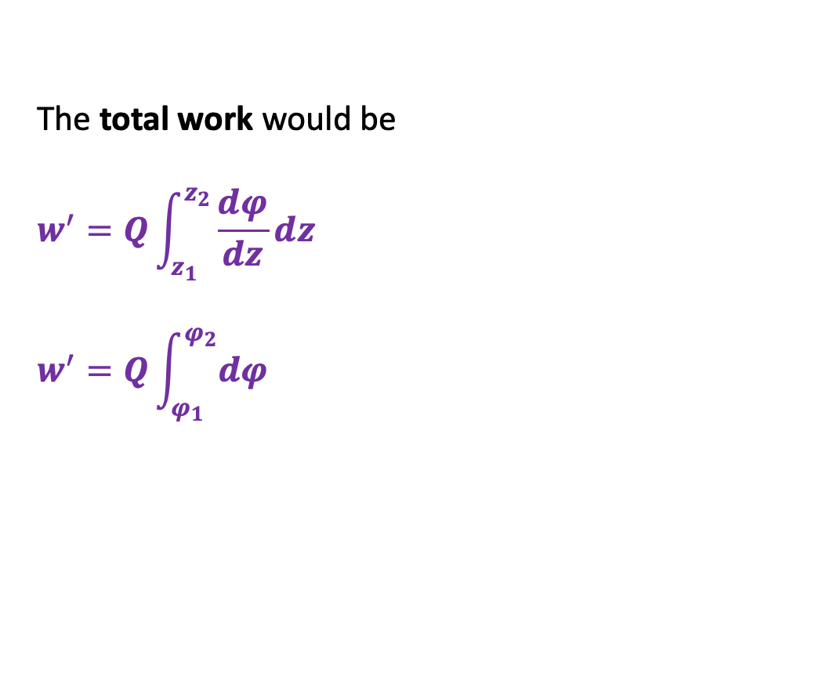
Electrical work for single ions
The total work would be
$$w^{′}=Q\int_{z_{1}}^{z_{2}}{\frac{dφ}{dz}}dz$$
$$w^{′}=Q\int_{φ_{1}}^{φ_{2}}{dφ}$$
$f=Q\frac{dφ}{dz}$
$distance=z$
$$E.g., Q_{proton}=1.6×{10}^{−19} C$$
-
+
-
+
$$e^{−}$$
-
Up-gradient
$$w^{′}>0$$
Spontaneous
$$w^{′}<0$$
+
-
+
-
+
$$H^{+}$$
-
Spontaneous
$$w^{′}<0$$
Up-gradient
$$w^{′}>0$$
+
-
+
$$φ$$
$$∆φ$$
$$∆z$$
$$z$$

Slide 9
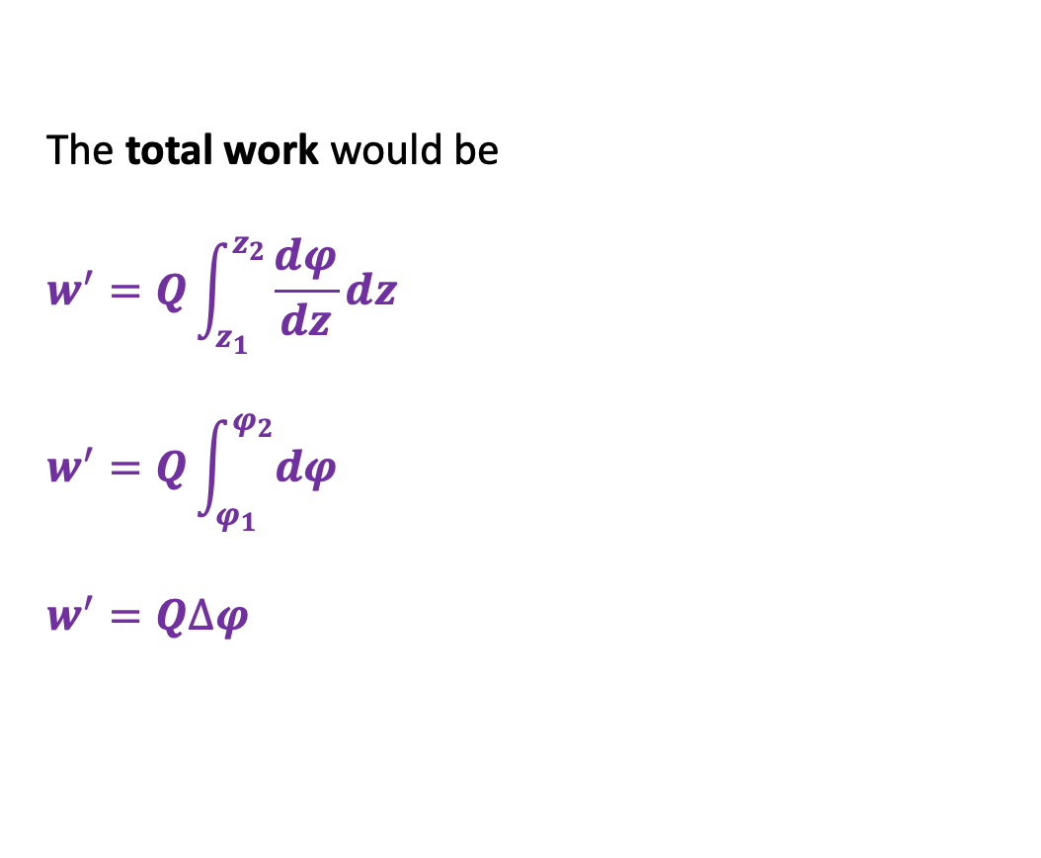
Electrical work for single ions
The total work would be
$$w^{′}=Q\int_{z_{1}}^{z_{2}}{\frac{dφ}{dz}}dz$$
$$w^{′}=Q\int_{φ_{1}}^{φ_{2}}{dφ}$$
$$w^{′}=Q∆φ$$
$f=Q\frac{dφ}{dz}$
$distance=z$
$$E.g., Q_{proton}=1.6×{10}^{−19} C$$
-
+
-
+
$$e^{−}$$
-
Up-gradient
$$w^{′}>0$$
Spontaneous
$$w^{′}<0$$
+
-
+
-
+
$$H^{+}$$
-
Spontaneous
$$w^{′}<0$$
Up-gradient
$$w^{′}>0$$
+
-
+
$$φ$$
$$∆φ$$
$$∆z$$
$$z$$

Slide 10
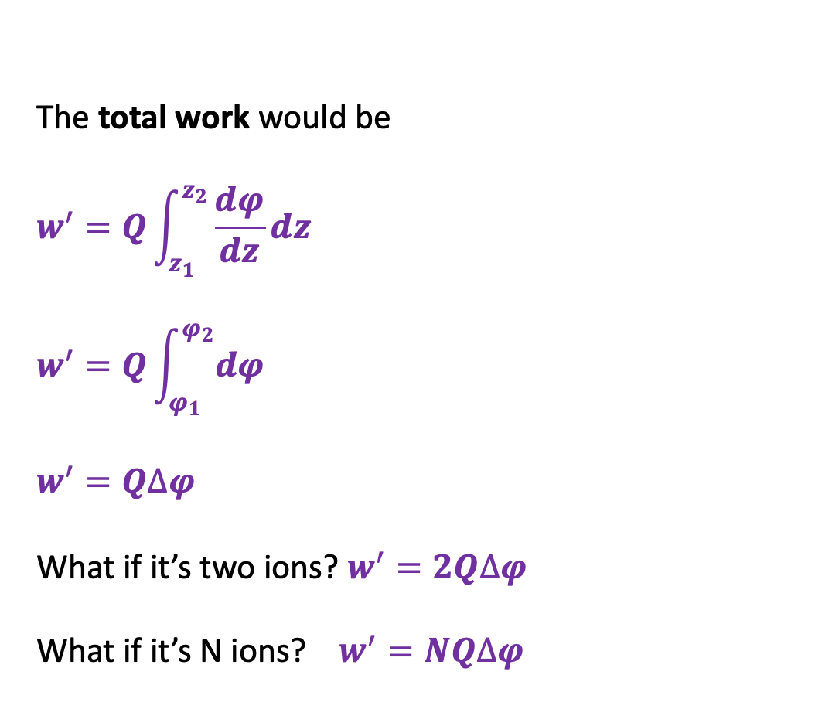
Electrical work for single ions
The total work would be
$$w^{′}=Q\int_{z_{1}}^{z_{2}}{\frac{dφ}{dz}}dz$$
$$w^{′}=Q\int_{φ_{1}}^{φ_{2}}{dφ}$$
$$w^{′}=Q∆φ$$
What if it’s two ions? $w^{′}=2Q∆φ$
What if it’s N ions? $w^{′}=NQ∆φ$
$f=Q\frac{dφ}{dz}$
$distance=z$
$$E.g., Q_{proton}=1.6×{10}^{−19} C$$
-
+
-
+
$$e^{−}$$
-
Up-gradient
$$w^{′}>0$$
Spontaneous
$$w^{′}<0$$
+
-
+
-
+
$$H^{+}$$
-
Spontaneous
$$w^{′}<0$$
Up-gradient
$$w^{′}>0$$
+
-
+
$$φ$$
$$∆φ$$
$$∆z$$
$$z$$

Slide 11
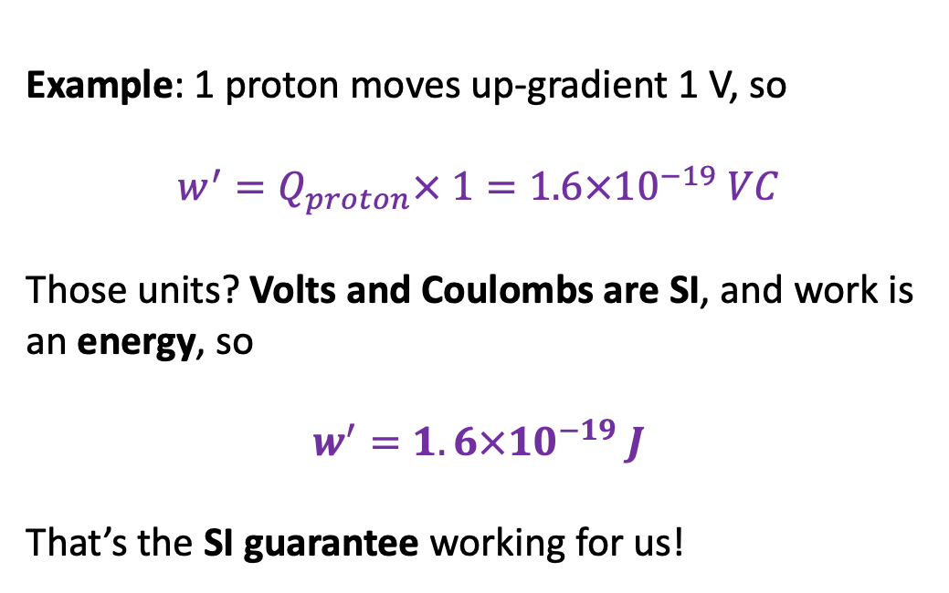
Electrical work for single ions
$f=Q\frac{dφ}{dz}$
$distance=z$
$$w^{′}=NQ∆φ$$
$$E.g., Q_{proton}=1.6×{10}^{−19} C$$
-
+
Example: 1 proton moves up-gradient 1 V, so
$$w^{′}=Q_{proton}× 1=1.6×{10}^{−19} VC$$
Those units? Volts and Coulombs are SI, and work is an energy, so
$$w^{′}=1.6×{10}^{−19} J$$
That’s the SI guarantee working for us!
-
+
$$e^{−}$$
-
Up-gradient
$$w^{′}>0$$
Spontaneous
$$w^{′}<0$$
+
-
+
-
+
$$H^{+}$$
-
Spontaneous
$$w^{′}<0$$
Up-gradient
$$w^{′}>0$$
+
-
+
$$φ$$
$$∆φ$$
$$∆z$$
$$z$$

Slide 12
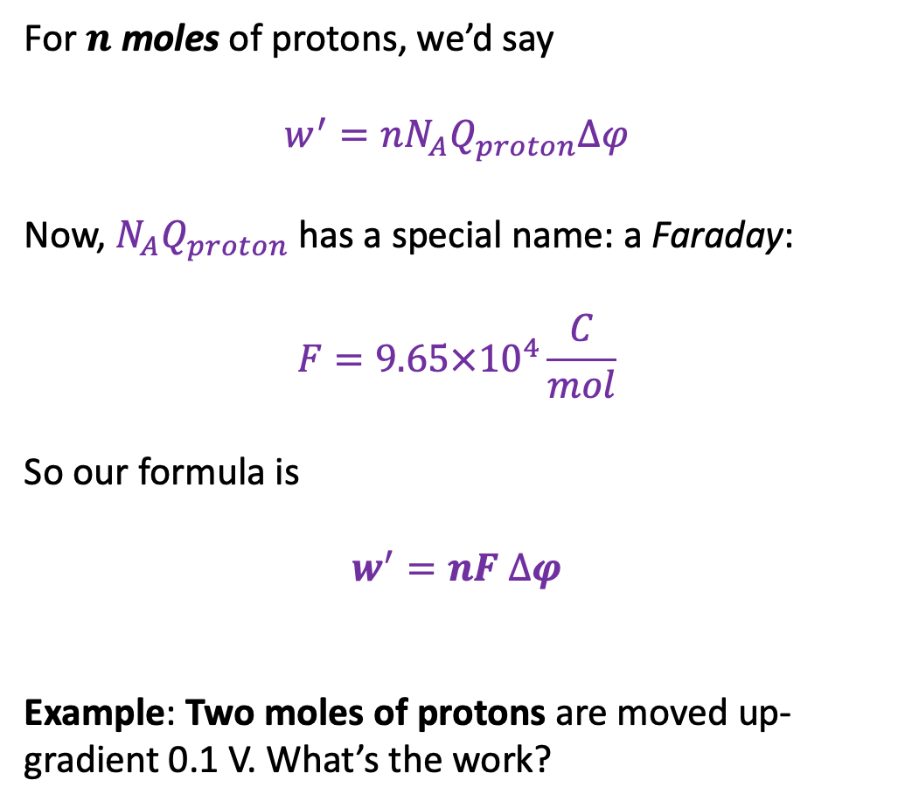
Electrical work for moles of ions
For $n$ moles of protons, we’d say
$$w^{′}={nN}_{A}Q_{proton}∆φ$$
Now, $N_{A}Q_{proton}$ has a special name: a Faraday:
$$F=9.65×{10}^{4}\frac{C}{mol}$$
So our formula is
$$w^{′}=nF ∆φ$$
Example: Two moles of protons are moved up-gradient 0.1 V. What’s the work?
$f=Q\frac{dφ}{dz}$
$distance=z$
-
+
-
+
$$e^{−}$$
-
Up-gradient
$$w^{′}>0$$
Spontaneous
$$w^{′}<0$$
+
-
+
-
+
$$H^{+}$$
-
Spontaneous
$$w^{′}<0$$
Up-gradient
$$w^{′}>0$$
+
-
+
$$φ$$
$$∆φ$$
$$∆z$$
$$z$$

Slide 13
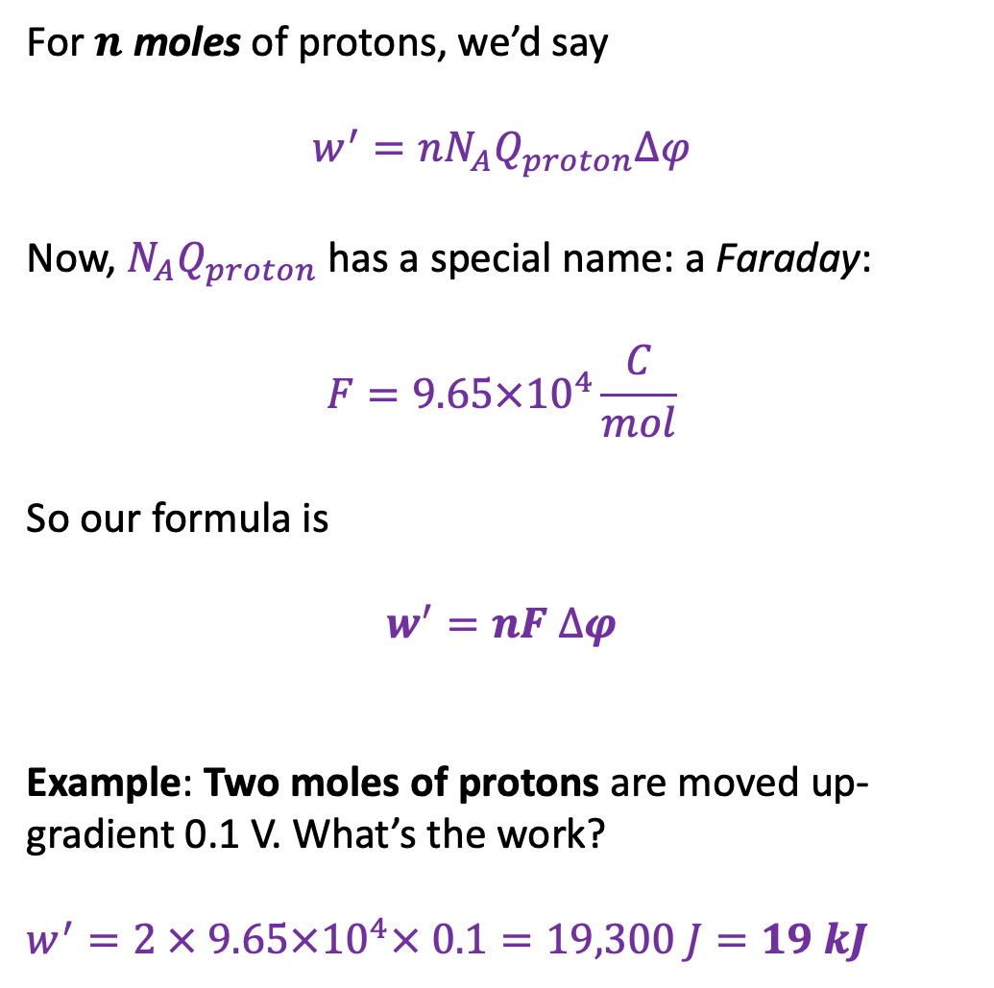
Electrical work for moles of ions
For $n$ moles of protons, we’d say
$$w^{′}={nN}_{A}Q_{proton}∆φ$$
Now, $N_{A}Q_{proton}$ has a special name: a Faraday:
$$F=9.65×{10}^{4}\frac{C}{mol}$$
So our formula is
$$w^{′}=nF ∆φ$$
Example: Two moles of protons are moved up-gradient 0.1 V. What’s the work?
$$w^{′}=2 × 9.65×{10}^{4}× 0.1=19,300 J=19 kJ$$
$f=Q\frac{dφ}{dz}$
$distance=z$
-
+
-
+
$$e^{−}$$
-
Up-gradient
$$w^{′}>0$$
Spontaneous
$$w^{′}<0$$
+
-
+
-
+
$$H^{+}$$
-
Spontaneous
$$w^{′}<0$$
Up-gradient
$$w^{′}>0$$
+
-
+
$$φ$$
$$∆φ$$
$$∆z$$
$$z$$

Slide 14

Electrical work for moles of ions
For $n$ moles of protons, we’d say
$$w^{′}={nN}_{A}Q_{proton}∆φ$$
Now, $N_{A}Q_{proton}$ has a special name: a Faraday:
$$F=9.65×{10}^{4}\frac{C}{mol}$$
So our formula is
$$w^{′}=nF ∆φ$$
Example: Two moles of Ca²⁺ ions are moved up-gradient 0.1 V. What’s the work?
$f=Q\frac{dφ}{dz}$
$distance=z$
-
+
-
+
$$e^{−}$$
-
Up-gradient
$$w^{′}>0$$
Spontaneous
$$w^{′}<0$$
+
-
+
-
+
$$H^{+}$$
-
Spontaneous
$$w^{′}<0$$
Up-gradient
$$w^{′}>0$$
+
-
+
$$φ$$
$$∆φ$$
$$∆z$$
$$z$$

Slide 15
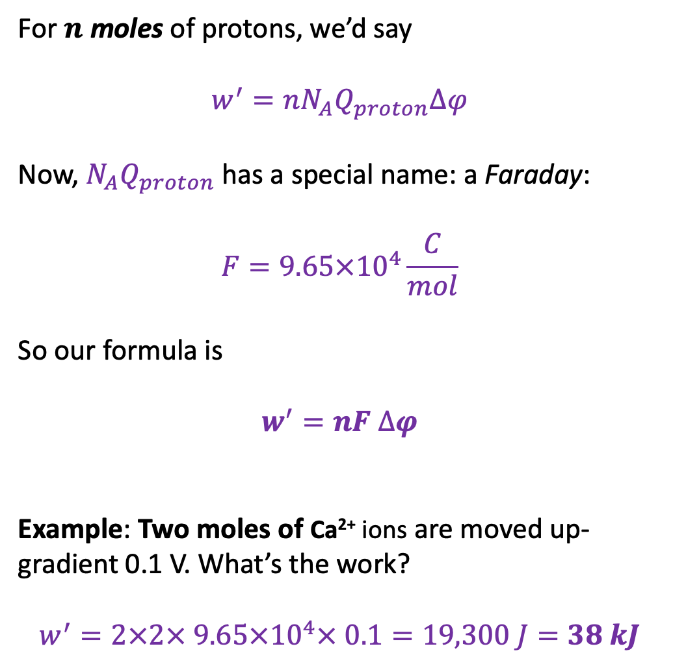
Electrical work for moles of ions
For $n$ moles of protons, we’d say
$$w^{′}={nN}_{A}Q_{proton}∆φ$$
Now, $N_{A}Q_{proton}$ has a special name: a Faraday:
$$F=9.65×{10}^{4}\frac{C}{mol}$$
So our formula is
$$w^{′}=nF ∆φ$$
Example: Two moles of Ca²⁺ ions are moved up-gradient 0.1 V. What’s the work?
$$w^{′}=2×2× 9.65×{10}^{4}× 0.1=19,300 J=38 kJ$$
$f=Q\frac{dφ}{dz}$
$distance=z$
-
+
-
+
$$e^{−}$$
-
Up-gradient
$$w^{′}>0$$
Spontaneous
$$w^{′}<0$$
+
-
+
-
+
$$H^{+}$$
-
Spontaneous
$$w^{′}<0$$
Up-gradient
$$w^{′}>0$$
+
-
+
$$φ$$
$$∆φ$$
$$∆z$$
$$z$$

Slide 16
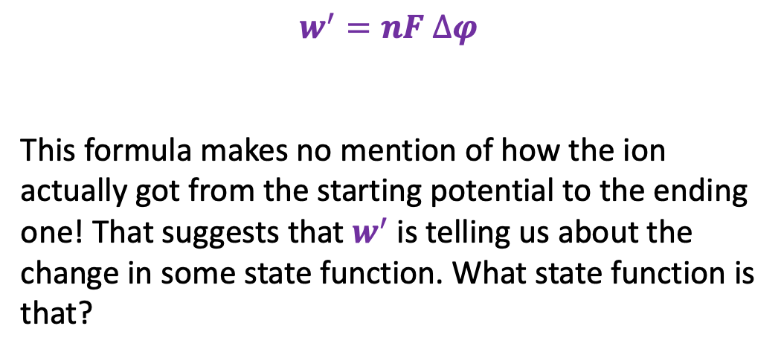
Path (in)dependence of electrical work?
$f=Q\frac{dφ}{dz}$
$distance=z$
$$w^{′}=nF ∆φ$$
This formula makes no mention of how the ion actually got from the starting potential to the ending one! That suggests that $w^{′}$is telling us about the change in some state function. What state function is that?
-
+
-
+
$$e^{−}$$
-
Up-gradient
$$w^{′}>0$$
Spontaneous
$$w^{′}<0$$
+
-
+
-
+
$$H^{+}$$
-
Spontaneous
$$w^{′}<0$$
Up-gradient
$$w^{′}>0$$
+
-
+
$$φ$$
$$∆φ$$
$$∆z$$
$$z$$

Slide 17
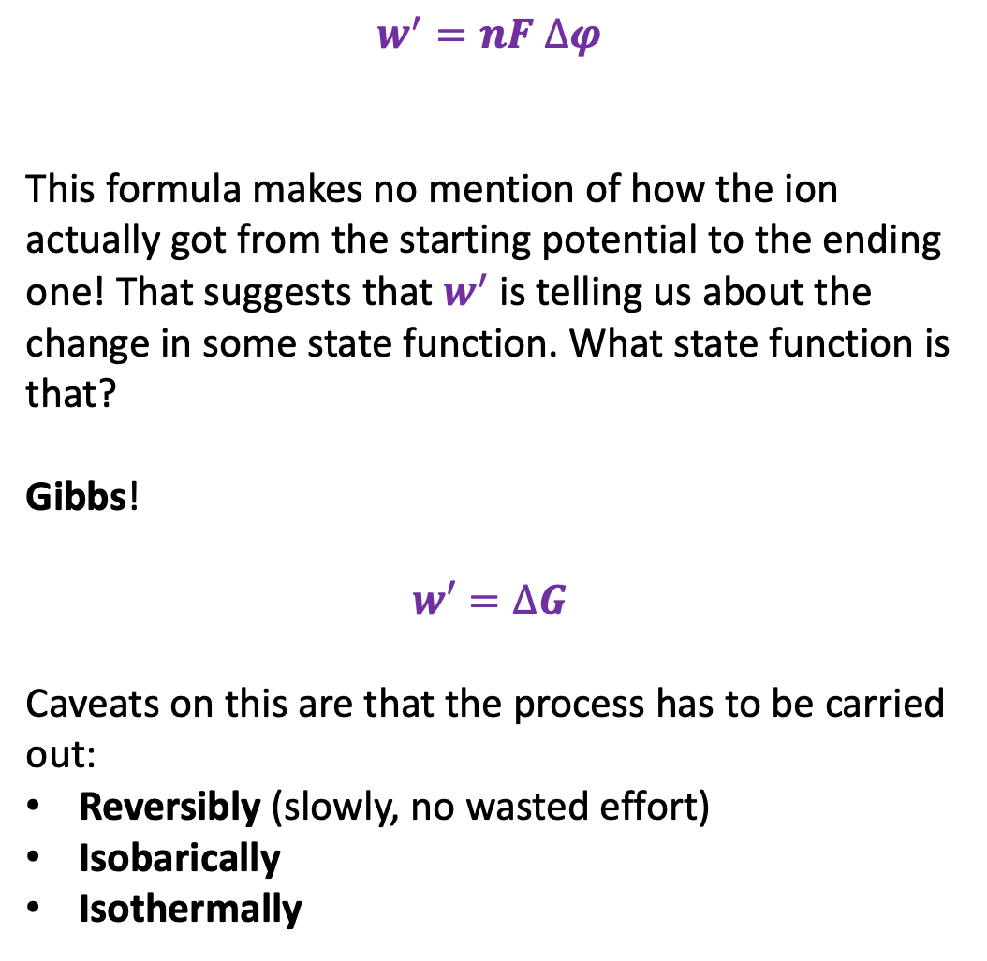
Path (in)dependence of electrical work?
$f=Q\frac{dφ}{dz}$
$distance=z$
$$w^{′}=nF ∆φ$$
This formula makes no mention of how the ion actually got from the starting potential to the ending one! That suggests that $w^{′}$is telling us about the change in some state function. What state function is that?
Gibbs!
$$w′=∆G$$
Caveats on this are that the process has to be carried out:
Reversibly (slowly, no wasted effort)
Isobarically
Isothermally
-
+
-
+
$$e^{−}$$
-
Up-gradient
$$w^{′}>0$$
Spontaneous
$$w^{′}<0$$
+
-
+
-
+
$$H^{+}$$
-
Spontaneous
$$w^{′}<0$$
Up-gradient
$$w^{′}>0$$
+
-
+
$$φ$$
$$∆φ$$
$$∆z$$
$$z$$

Slide 18
Today
Non-PV work
Definition
Electrical work associated with moving around single ions, moles of ions
Concentration work
Context for CGI exercises
Relationship to Gibbs and the 2nd Law

Slide 19
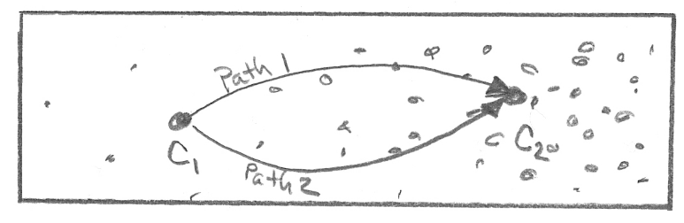
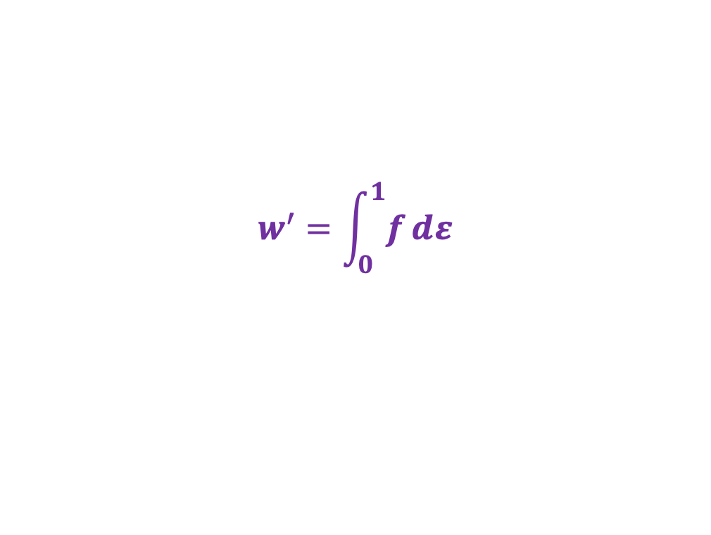
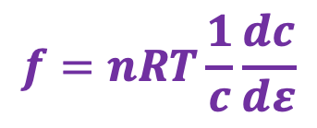


Concentration work as a force through a dimensionless “distance” $ε$
$$f=nRT\frac{1}{c}\frac{dc}{dε}$$
Force
$$w^{′}=\int_{0}^{1}{f}dε$$
Work
$$ε=1$$
$$ε=0$$

Slide 20


Concentration work as a force through a dimensionless “distance” $ε$
$$f=nRT\frac{1}{c}\frac{dc}{dε}$$
Force
$$w^{′}=\int_{0}^{1}{f}dε$$
Work
Question: Is there a state function that corresponds to this work?
$$ε=1$$
$$ε=0$$

Slide 21
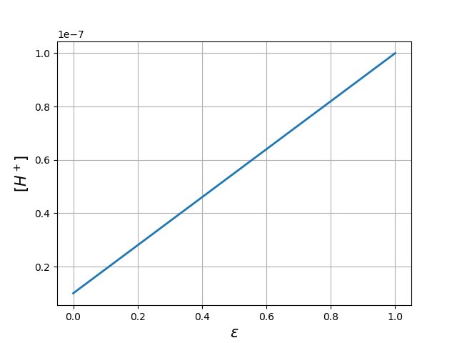
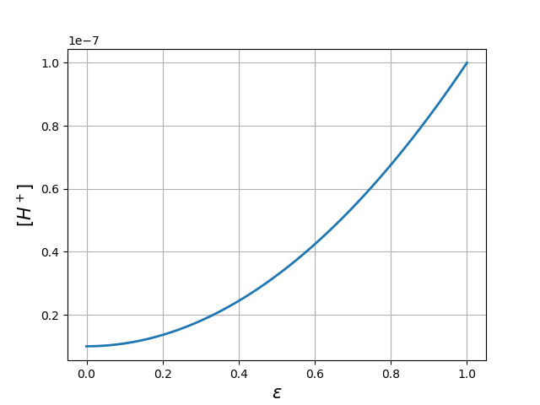
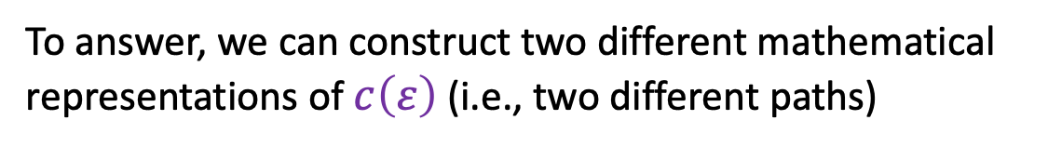


Concentration work as a force through a dimensionless “distance” $ε$
To answer, we can construct two different mathematical representations of $c\left(ε\right)$ (i.e., two different paths)
$$f=nRT\frac{1}{c}\frac{dc}{dε}$$
Force
$$Path 1$$
$$w^{′}=\int_{0}^{1}{f}dε$$
Work
Question: Is there a state function that corresponds to this work?
$$Path 2$$
$$ε=1$$
$$ε=0$$

Slide 22
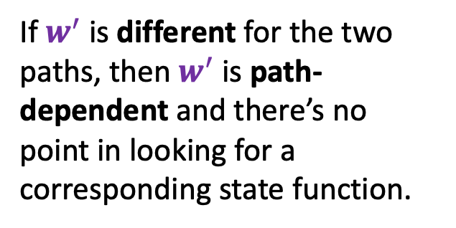


Concentration work as a force through a dimensionless “distance” $ε$
To answer, we can construct two different mathematical representations of $c\left(ε\right)$ (i.e., two different paths)
$$f=nRT\frac{1}{c}\frac{dc}{dε}$$
Force
If $w^{′}$ is different for the two paths, then $w^{′}$ is path-dependent and there’s no point in looking for a corresponding state function.
$$Path 1$$
$$w^{′}=\int_{0}^{1}{f}dε$$
Work
Question: Is there a state function that corresponds to this work?
$$Path 2$$
$$ε=1$$
$$ε=0$$

Slide 23
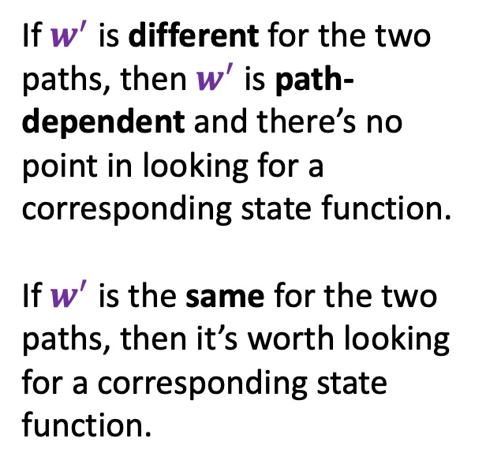
Concentration work as a force through a dimensionless “distance” $ε$
To answer, we can construct two different mathematical representations of $c\left(ε\right)$ (i.e., two different paths)
$$f=nRT\frac{1}{c}\frac{dc}{dε}$$
Force
If $w^{′}$ is different for the two paths, then $w^{′}$ is path-dependent and there’s no point in looking for a corresponding state function.
If $w^{′}$ is the same for the two paths, then it’s worth looking for a corresponding state function.
$$Path 1$$
$$w^{′}=\int_{0}^{1}{f}dε$$
Work
Question: Is there a state function that corresponds to this work?
$$Path 2$$
$$ε=1$$
$$ε=0$$

Slide 24
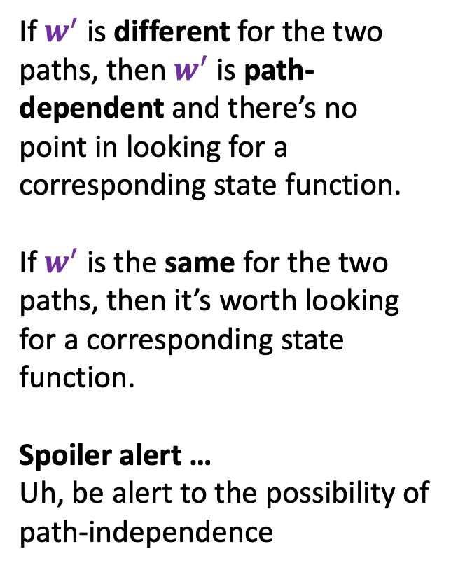
Concentration work as a force through a dimensionless “distance” $ε$
To answer, we can construct two different mathematical representations of $c\left(ε\right)$ (i.e., two different paths)
$$f=nRT\frac{1}{c}\frac{dc}{dε}$$
Force
If $w^{′}$ is different for the two paths, then $w^{′}$ is path-dependent and there’s no point in looking for a corresponding state function.
If $w^{′}$ is the same for the two paths, then it’s worth looking for a corresponding state function.
Spoiler alert …
Uh, be alert to the possibility of path-independence
$$Path 1$$
$$w^{′}=\int_{0}^{1}{f}dε$$
Work
Question: Is there a state function that corresponds to this work?
$$Path 2$$
$$ε=1$$
$$ε=0$$

Slide 25
Today
Non-PV work
Definition
Electrical work associated with moving around single ions, moles of ions
Concentration work
Context for CGI exercises
Relationship to Gibbs and the 2nd Law

Slide 26

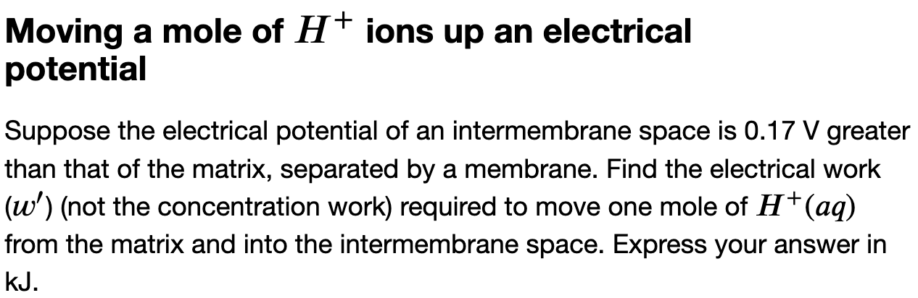
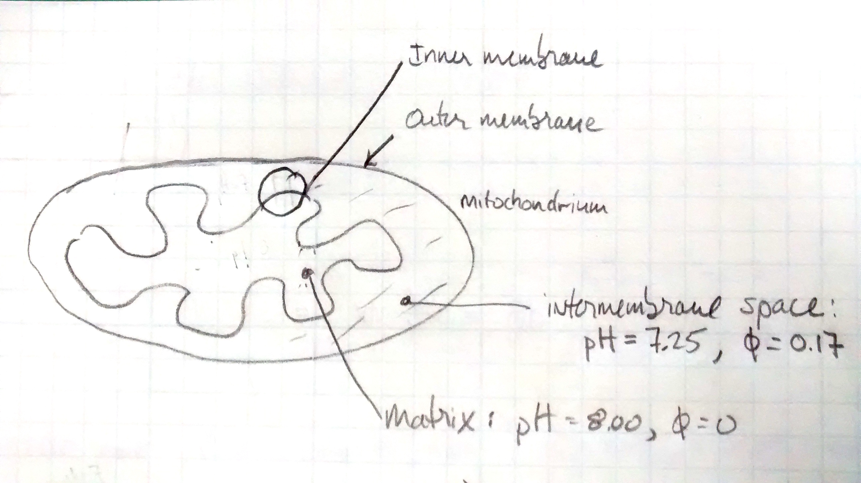
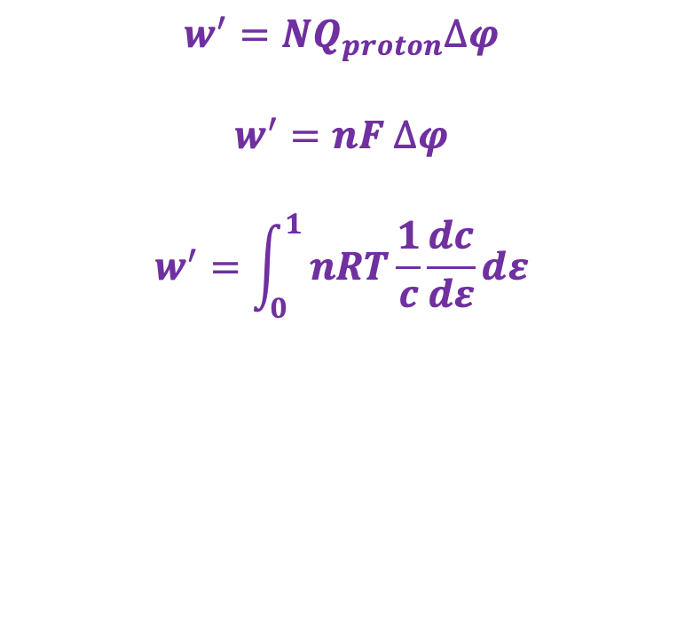
Context for CGI exercises
$$w^{′}=NQ_{proton}∆φ$$
$$w^{′}=nF ∆φ$$
$$w^{′}=\int_{0}^{1}{nRT\frac{1}{c}\frac{dc}{dε}}dε$$

Slide 27
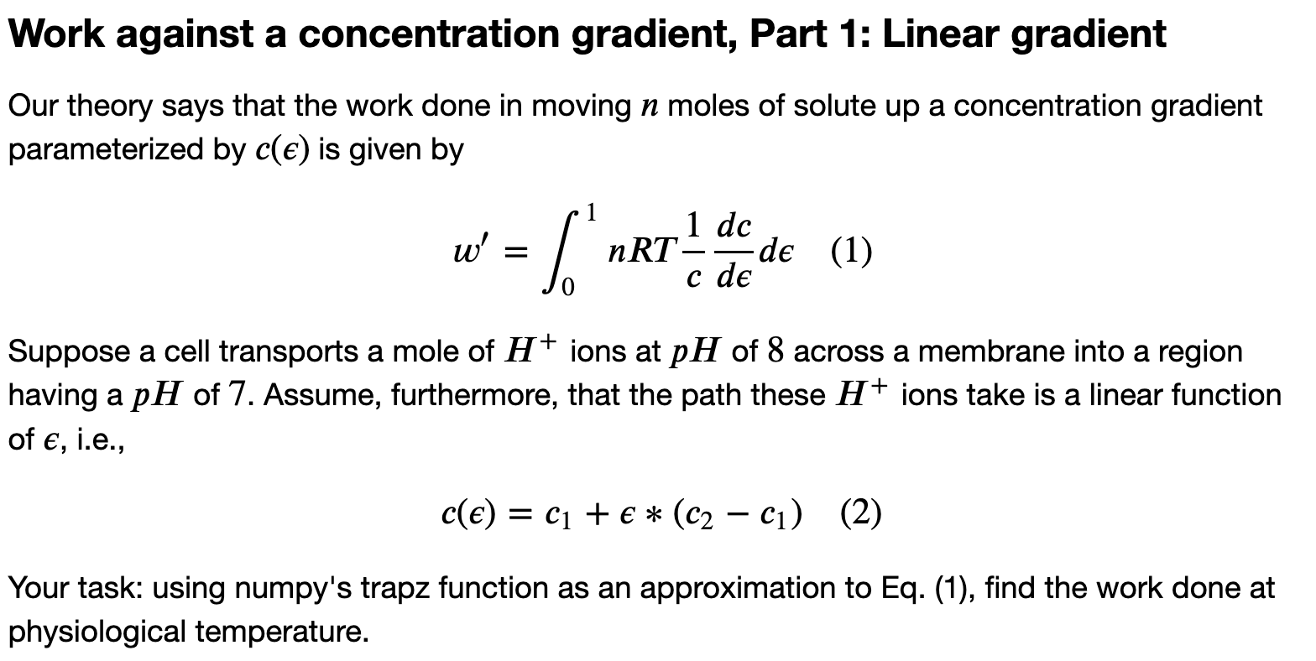
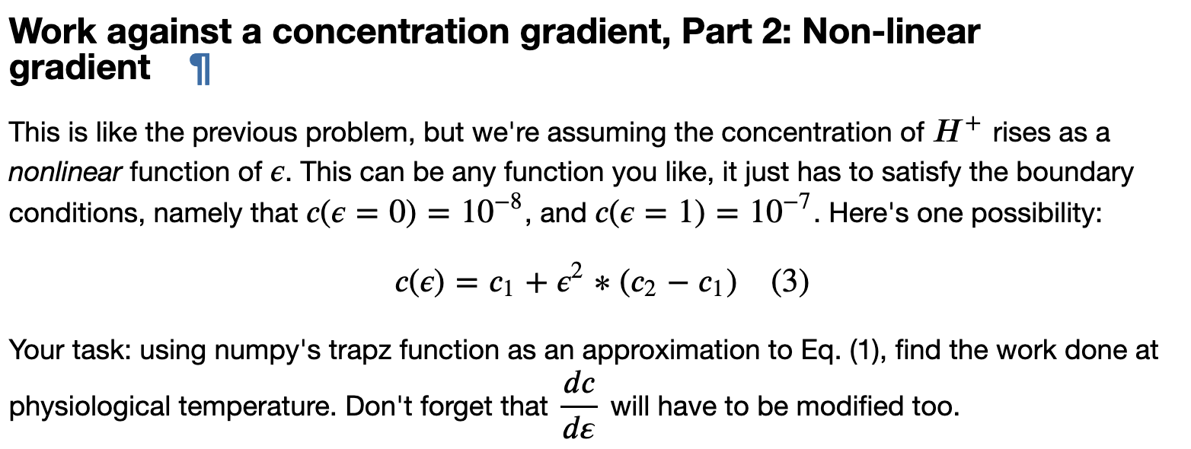
Context for CGI exercises
$$w^{′}=NQ_{proton}∆φ$$
$$w^{′}=nF ∆φ$$
$$w^{′}=\int_{0}^{1}{nRT\frac{1}{c}\frac{dc}{dε}}dε$$

Slide 28
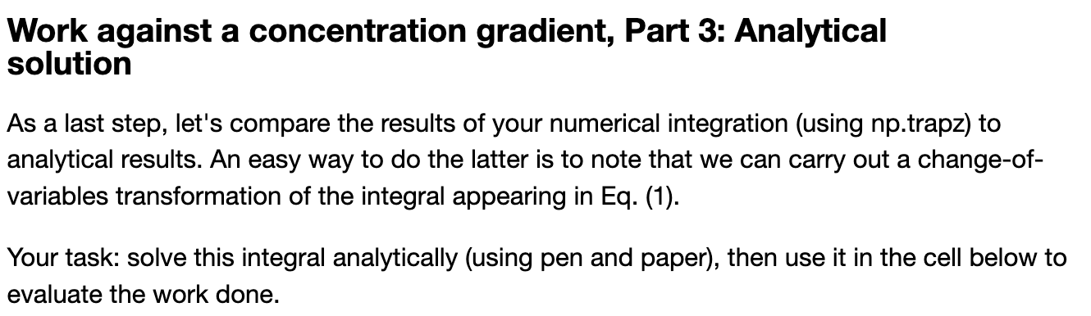
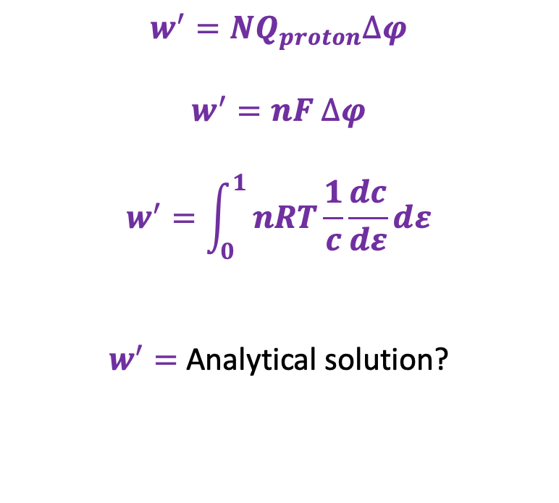
Context for CGI exercises
$$w^{′}=NQ_{proton}∆φ$$
$$w^{′}=nF ∆φ$$
$$w^{′}=\int_{0}^{1}{nRT\frac{1}{c}\frac{dc}{dε}}dε$$
$w^{′}=$ Analytical solution?

Slide 29
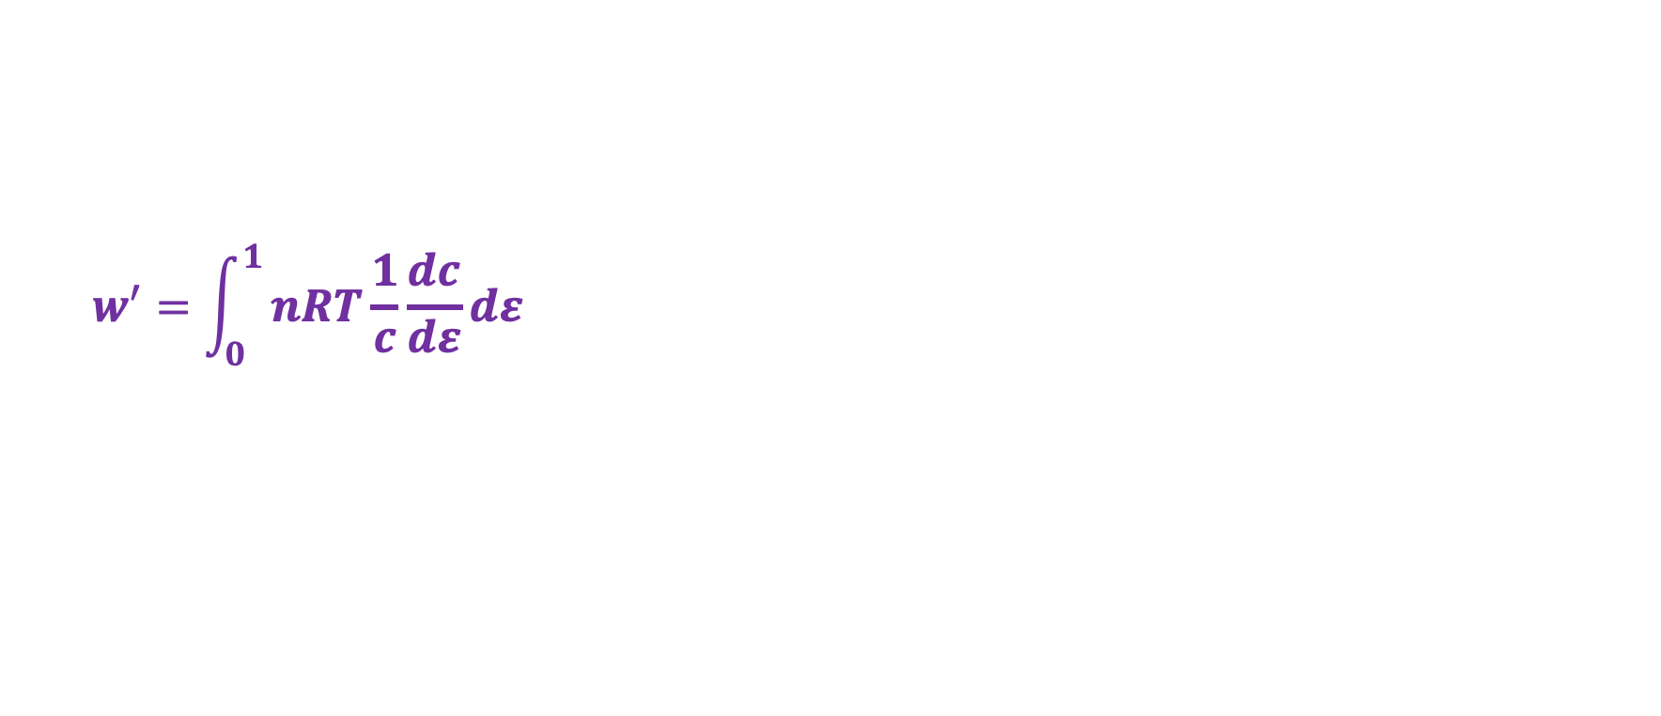
That analytical solution …
$$w^{′}=\int_{0}^{1}{nRT\frac{1}{c}\frac{dc}{dε}}dε$$
Constant temperature

Slide 30
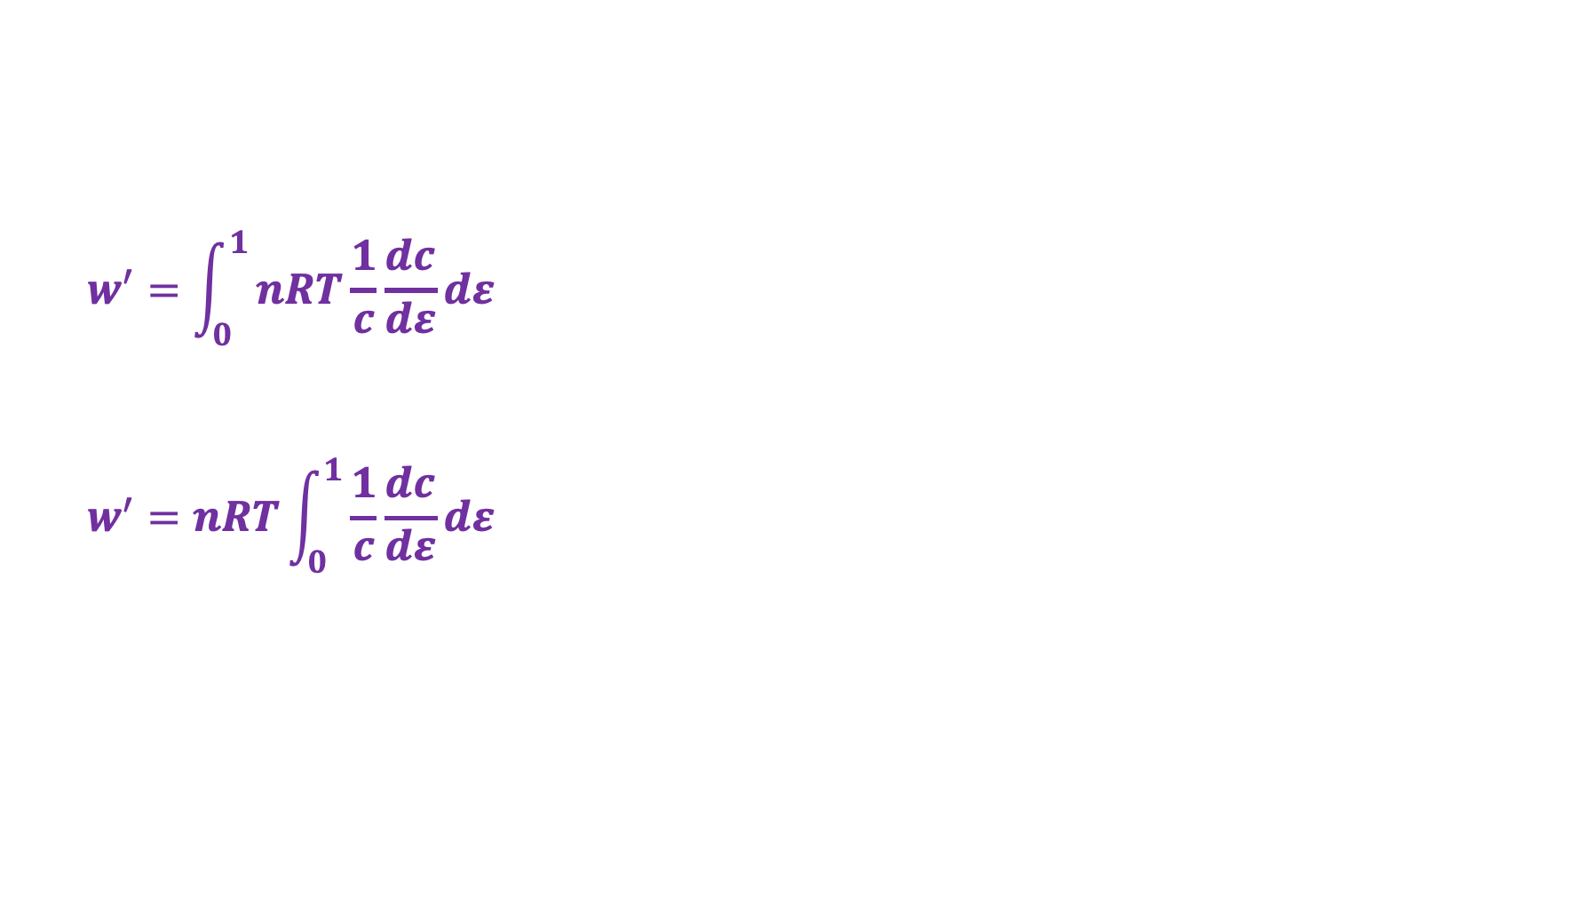
That analytical solution …
$$w^{′}=\int_{0}^{1}{nRT\frac{1}{c}\frac{dc}{dε}}dε$$
$$w^{′}=nRT\int_{0}^{1}{\frac{1}{c}\frac{dc}{dε}}dε$$
Constant temperature

Slide 31
That analytical solution …
$$w^{′}=\int_{0}^{1}{nRT\frac{1}{c}\frac{dc}{dε}}dε$$
$$w^{′}=nRT\int_{0}^{1}{\frac{1}{c}\frac{dc}{dε}}dε$$
Constant temperature
Variable substitution

Slide 32
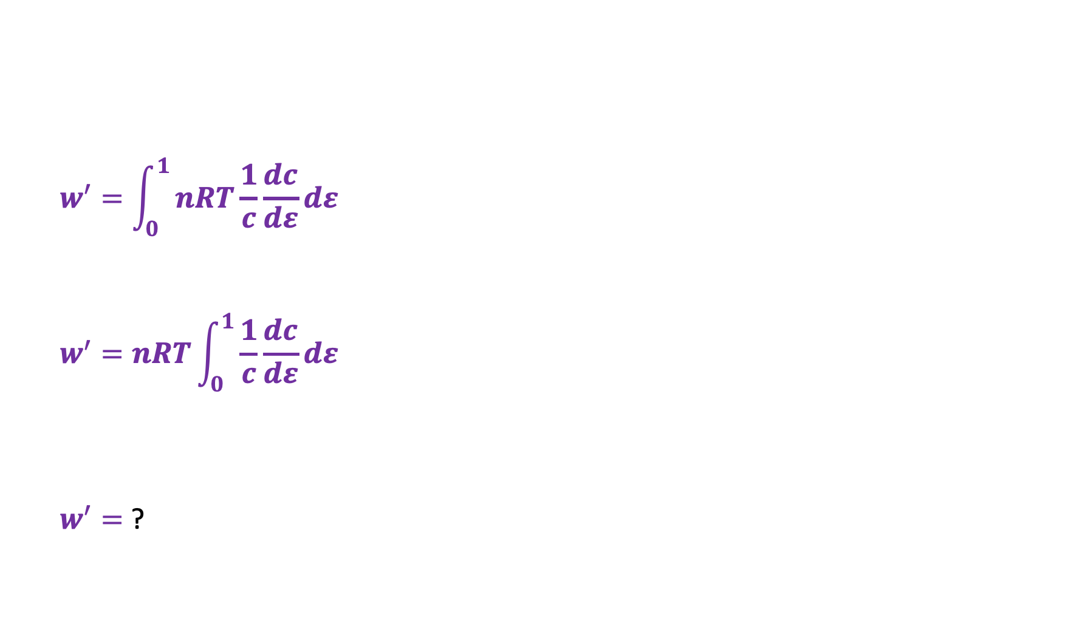
That analytical solution …
$$w^{′}=\int_{0}^{1}{nRT\frac{1}{c}\frac{dc}{dε}}dε$$
$$w^{′}=nRT\int_{0}^{1}{\frac{1}{c}\frac{dc}{dε}}dε$$
$w^{′}=$ ?
Constant temperature
Variable substitution
Don’t forget to reset integration limits too

Slide 33
Today
Non-PV work
Definition
Electrical work associated with moving around single ions, moles of ions
Concentration work
Context for CGI exercises
Relationship to Gibbs and the 2nd Law

Slide 34
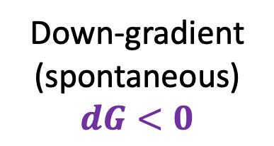
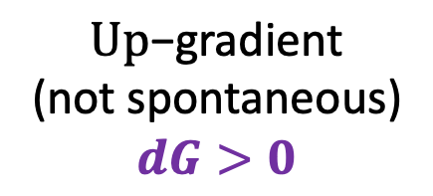
$∆G$ and the 2nd Law: we already could have guessed this, right?
State “X”
(Higher G)
$\text{U}\text{p}\text{−}\text{gradient}$
(not spontaneous)
$$dG>0$$
Down-gradient
(spontaneous)
$$dG<0$$
State “Y”

Slide 35
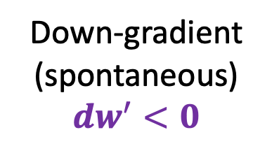
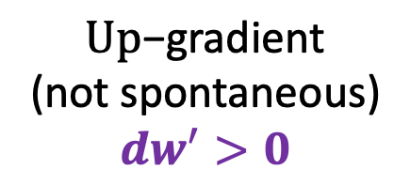
$∆G$ and the 2nd Law: we already could have guessed this too, right?
State “X”
(Higher G)
$\text{U}\text{p}\text{−}\text{gradient}$
(not spontaneous)
$${dw}^{′}>0$$
Down-gradient
(spontaneous)
$${dw}^{′}<0$$
State “Y”

Slide 36
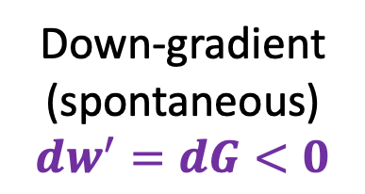
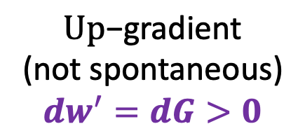
Reversible non-PV work equals the change in Gibbs energy!
State “X”
(Higher G)
$\text{U}\text{p}\text{−}\text{gradient}$
(not spontaneous)
$${dw}^{′}=dG>0$$
Down-gradient
(spontaneous)
$${dw}^{′}=dG<0$$
State “Y”

Slide 37
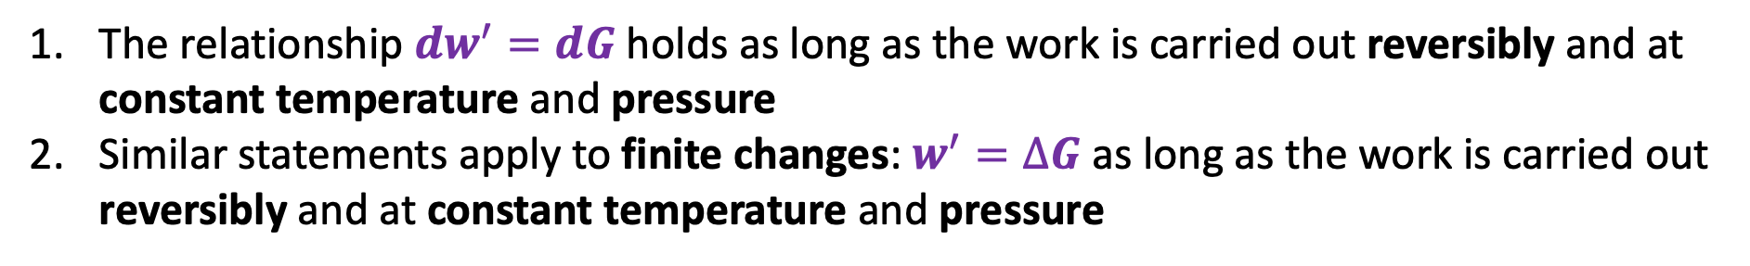
Reversible non-PV work equals the change in Gibbs energy!
State “X”
(Higher G)
$\text{U}\text{p}\text{−}\text{gradient}$
(not spontaneous)
$${dw}^{′}=dG>0$$
Down-gradient
(spontaneous)
$${dw}^{′}=dG<0$$
State “Y”
The relationship ${dw}^{′}=dG$ holds as long as the work is carried out reversibly and at constant temperature and pressure
Similar statements apply to finite changes: $w^{′}=∆G$ as long as the work is carried out reversibly and at constant temperature and pressure

Slide 38
What we learned …
How to write the force and calculate the non-PV work associated with electrical gradients
How to write the force and calculate the non-PV work associated with concentration gradients
State what the sign of the work tells us about spontaneity
State the conditions under which these forms of non-PV work equal the change in Gibbs energy (reversible, isobaric, and isothermal)

